Slide 1
Effect of Feedback on Closed loop System

Slide 2






What is a System?
A collection of physical, biological or abstract components which together
perform an intended objective
A system gives an output (also called response) for an input (also called excitation)
Input /
Excitation
System
Output /
Response
System can be a collection of multiple sub-systems
SS2
Input /
Excitation
Output / Response
SS1
+
SS3
SS4
System (with 4 sub-systems)

Slide 3
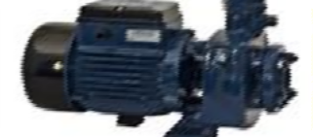
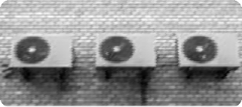


Examples of System
Motor
Input – Electrical energy (voltage)
Output – Mechanical energy (Torque / Rotation)
Air conditioner
Input – Electrical energy (voltage)
Output – Heat energy (Changes the ambient temperature)
Human body infected with a virus
Input – Drug administration
Output – Drug distribution & effect on the body
Vehicle (car or bus)
Input – Acceleration or Deceleration
Output – Vehicle displacement

Slide 4
What is a Control System?
A system or mechanism which directs the input to other systems and regulates their output
Control system alters the response of a plant or system as
desired
Desired Reference
Control Input
Plant or
System
To be controlled
Controller
Output
Control System

Slide 5
Disturbance
Unwanted signals which affect the output of the system
E.g. People entering and leaving an AC room disturbs room
temperature
Controller has to eliminate the effects of disturbance
Human body infected with a virus
Input – Drug administration
Output – Drug distribution & effect on the body
Human body infected with a virus
Input – Drug administration
Output – Drug distribution & effect on the body
Disturbance
Desired Reference
Control Input
Plant or System
To be controlled
Output
Controller
Control System

Slide 6
Feedback in Control
Feedback senses the plant output and gives a signal which can be compared to the reference
Controller action (control input) changes based on feedback
Feedback enables the control system in extracting the desired
performance from the plant even in presence of disturbance
Disturbance
Desired
Reference
Control Input
Response / Output
Plant
or System
To
be controlled
Controller
Control System
Feedback

Slide 7









Examples of Control Systems
Actual temp
Input
Temp
Setting knob
On/
Off Switch
Air
Conditioned
Room
What is the process or plant?
What is the output?
What is the desired input?
What are the subsystems?
What is the actuator?
14

Slide 8
Examples of Control Systems
Air conditioner maintaining desired temperature:
: Room
: Air Conditioner
: Desired temperature
: Compressor ON/OFF
: Output temperature
: Factors affecting ambient temperature
: Measured temperature
Plant
Control system
Reference
Control Input
Output
Disturbance
Feedback
People in the Room
Temperature Setting Knob
Desired Temperature
ON OFF
Switch
Air Conditioner
\
Room
Actual Temperature
8

Slide 9
Examples of Control Systems
Human steering an automobile:
Plant
Control system
Reference
Control Input
Output
Disturbance
Feedback
: Vehicle or automobile
: Human control
: Desired destination
: Steering mechanism
: Actual position
: Traffic conditions
: Sensing (Human Senses)
Traffic conditions
Desired
Destination
Steering
Mechanism
Human Control
Vehicle / Automobile
Actual position
Sensing
9

Slide 10
Effect of Feedback on Closed loop System
Negative Feedback reduce the overall Gain
Negative Feedback reduce the sensitivity of system to parameter variations
Negative Feedback increase System Bandwidth result faster system response.
Reduce the effect of noise and disturbances
Negative feed improve the stability???
Improve input and output impedance

Slide 11
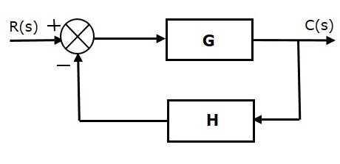
Negative Feedback
Negative feedback reduces the error between the reference input, R(s) and system output
E(s)
B(s)
Fig: Block diagram of the negative feedback control system
Transfer function of negative feedback control system is,
T=G/1+GH

Slide 12
T = G/1+GH
Where,
T is the transfer function or overall gain
G is the open loop gain
H is the gain of feedback path

Slide 13

Transfer Function(Closed loop Gain)????
Transfer function T(S)=C(S)/R(S)
C(S)=E(S) G(S) .. (1)
E(S)=R(S)-B(S) …(2)
B(S)=H(S)C(S) …(3)
From eq(1), (2), and (3) we get
C(S)=R(S) G(S) - G(S) H(S) C(S)
C(S)[1+G(S)H(S)]=R(S)G(S)
E(s)
(S)
B(s)
(S)

Slide 14
T = G/1+GH
1)Effect of Feedback on Overall Gain
The overall gain may increase or decrease depending on Feedback the value of (1+GH).
If the value of (1+GH) is greater than 1(Negative Feedback), then the overall gain decreases
If the value of (1+GH) is less than 1(positive feedback), then the overall gain increases.

Slide 15
T = G/1+GH
In general, 'G' and 'H' are functions of frequency. So, the feedback will increase the overall gain of the system in one frequency range and decrease in the other frequency range

Slide 16
Effect of Feedback on Bandwidth
As Gain bandwidth product is constant as gain of Closed loop system is Decrease by a Factor (1+GH) than Bandwidth increase by a factor (1+GH)
Closed loop BW= Open loop BW x (1+GH)
BW improve the Transient response of the System

Slide 17

Effect of Feedback on Sensitivity
Sensitivity: of the overall gain of negative feedback closed loop control system (T) to the variation in open loop gain (G) is defined as
Where, ∂T is the incremental change in T due to incremental change in G.

Slide 18



Effect of Feedback on Sensitivity
So, sensitivity of the overall gain of closed loop control system as the reciprocal of (1+GH). So, Sensitivity decrease depending on the value of (1+GH)/ Feedback.
If the value of (1+GH) is greater than 1, then sensitivity decreases (Negative Feedback).
If the value of (1+GH) is less than 1, then sensitivity increases (positive Feedback).

Slide 19
Effect of Feedback on Sensitivity
In general, 'G' and 'H' are functions of frequency. So, feedback will increase the sensitivity of the system gain in one frequency range and decrease in the other frequency range

Slide 20
Effect of Feedback on Stability
Closed loop TF = G/1+GH
A system is said to be stable, if its output is under control. Otherwise, it is said to be unstable.
if the denominator value is zero (i.e., GH = -1), then the output of the control system will be infinite. So, the control system becomes unstable.
Therefore, we have to properly choose the feedback in order to make the control system stable. Negative feedback improve stability

Slide 21




Sensitivity of closed loop TF(T) w.r.t variation in feedback sensor H
Sensitivity: of the overall gain of negative feedback closed loop control system (T) to the variation in Feed Sensor (H) is defined as

Slide 22

Sensitivity of closed loop TF(T) w.r.t feedback sensor H
For Large value of GH the sensitivity of closed loop feedback system w.r.t. H is unity.
Thus change in H directly effect the system output.

Slide 23
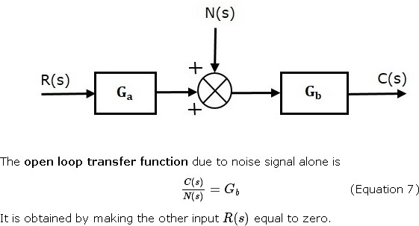
Effect of Feedback on Noise
Consider an open loop control system with noise signal as shown below.

Slide 24
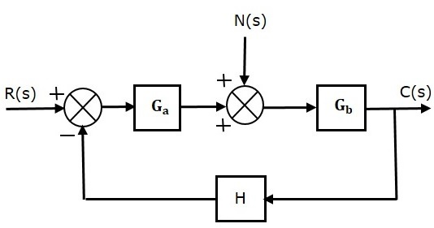

Effect of Feedback on Noise
To know the effect of feedback on noise, let us compare the transfer function relations with and without feedback due to noise signal alone.
Noise

Slide 25
Effect of Feedback on Noise
In the closed loop control system, the gain due to noise signal is decreased by a factor of (1+GaGbH) provided that the term (1+GaGbH) is greater than one.
To reduce the effect of noise Ga should be as large as possible

Slide 26
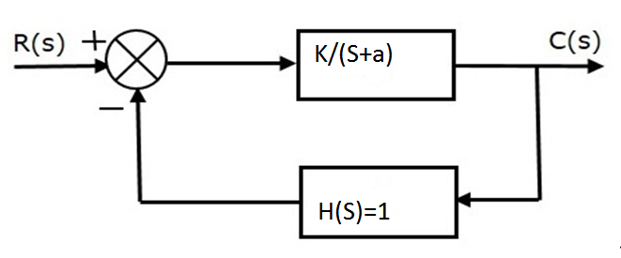

Effect on Feedback on System Dynamics
Open Loop TF G(S) =
Closed Loop TF

Slide 27
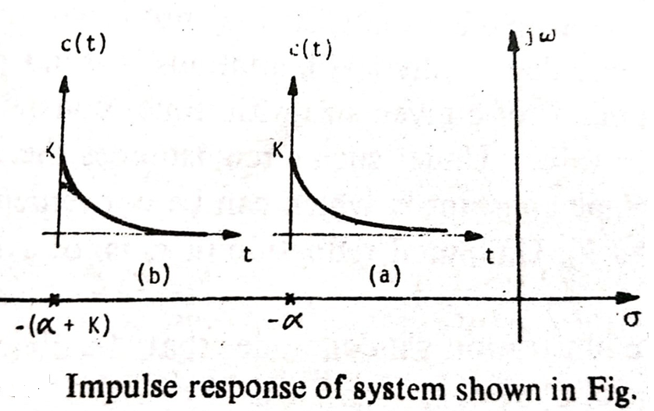
Effect on Feedback on System Dynamics
Closed loop
Faster than Open loop
Open loop

